Slide 1


Slide 2
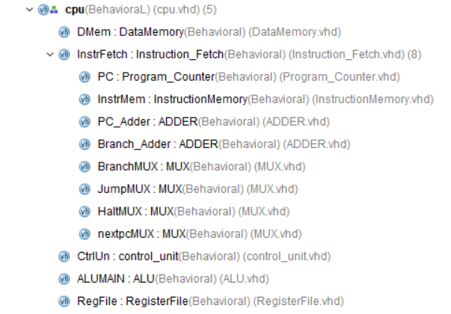
Structure

Slide 3
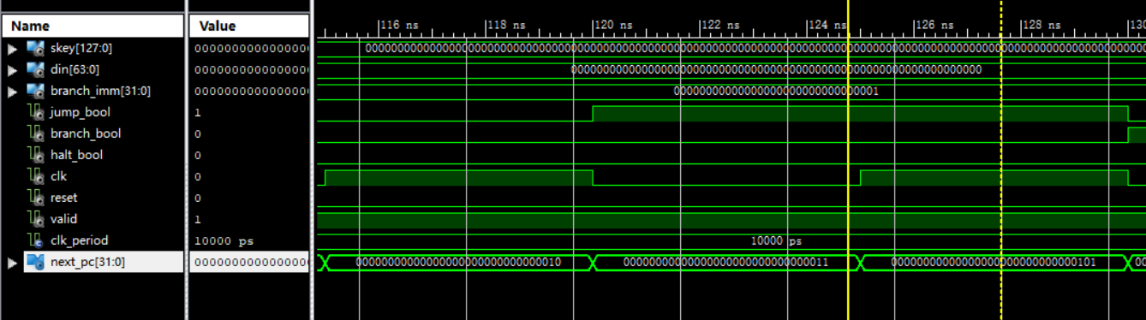
Functional Simulation
Instruction Fetch_PC Jump

Slide 4
Functional Simulation
Control Unit

Slide 5
Functional Simulation
Integrated Processor

Slide 6
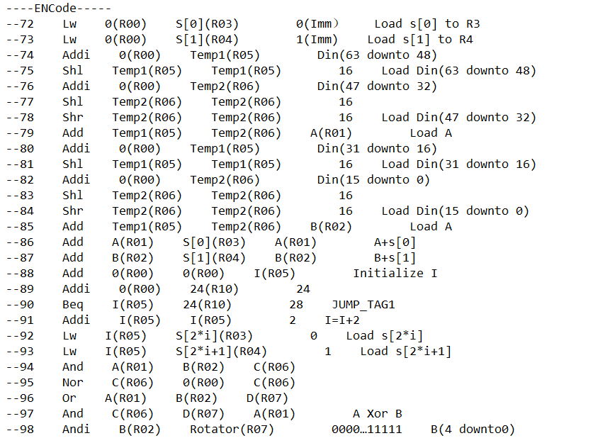
Assembly Code

Slide 7
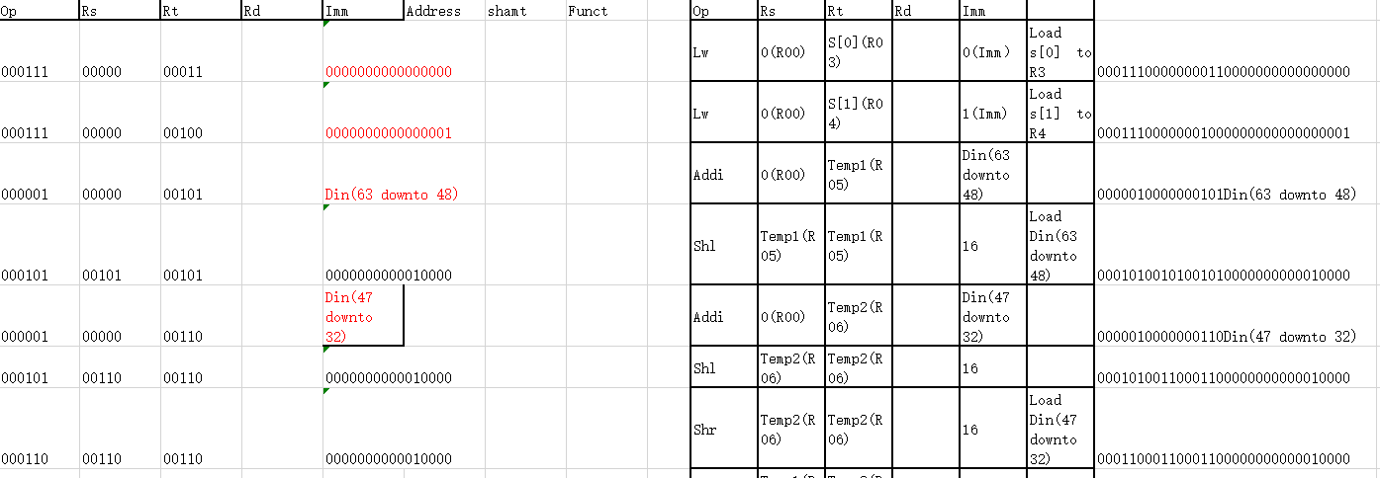
Machine Code

